Slide 1

Goal Journal Management System
CMPT 120L

Slide 2
About
Contact Information
Sean Bruno
Sophomore
Major: Applied Math
Sean.bruno1@marist.edu

Slide 3
Outline
The Goal Journal Management System is designed for users to write completed tasks down that help them reach a goal.
The user will be able to add, remove, edit, and search journal entries, all from a main menu

Slide 4
Project Objective
Admin:
- Be able to add a new user
- Remove a user
- Assign a role to users (admin or user)
User:
Can add or remove a journal entry
Can edit a previous journal entry
Can search by date to find previous entries
Goal Journal Management System:
Login Page
Admin Page
Main Menu

Slide 5
Project Description
Goal Journal Management System will do the following:
Be user friendly
Recognize if an admin or user is logging in
Display all entries on the main menu/Display all users on Admin menu
Allow user to exit whenever
Save all information when program is closed
Creates a journal for each user

Slide 6
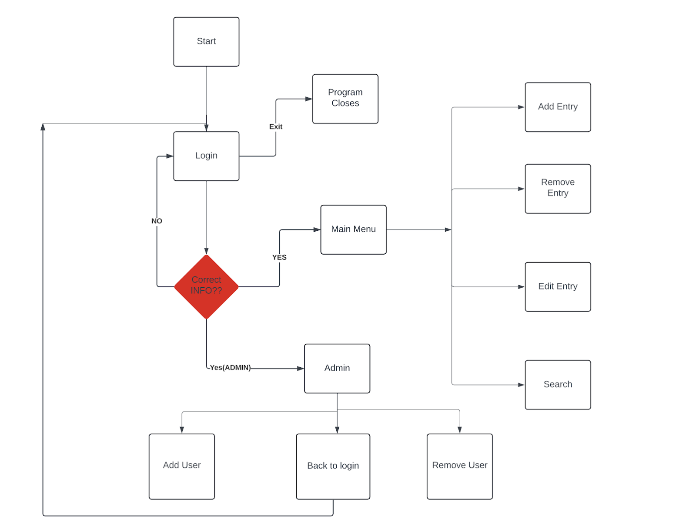
User Experience
User starts at login
-Wrong login information, will be sent back to login
Correct, then will be recognized as a user or admin
If an admin, then will be sent to admin menu
Admin can add or remove a user, or go back to login from admin menu
User will be directed to the Main

Slide 7
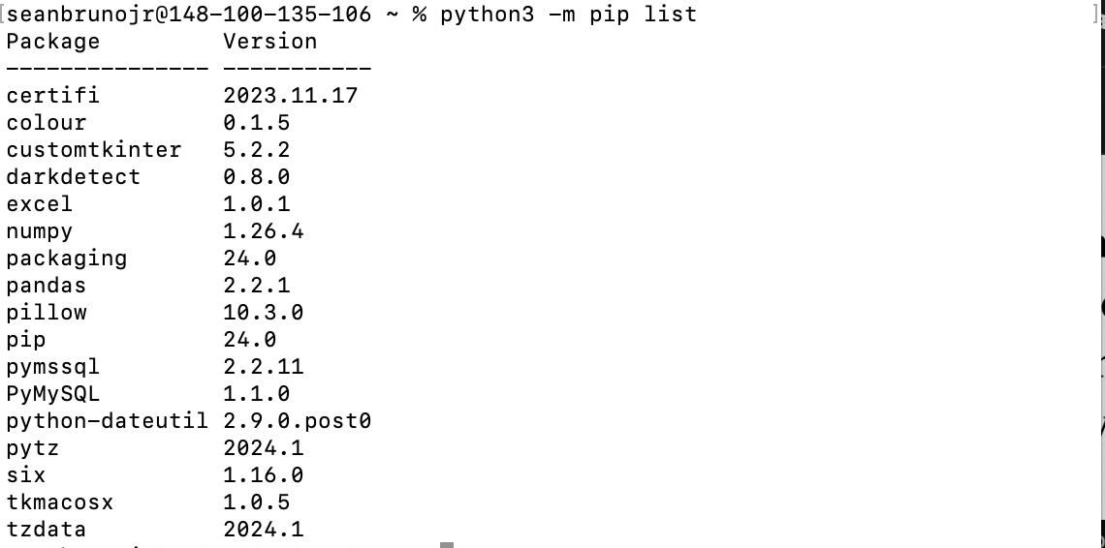
Virtual Environment
Created virtual environment in terminal
List of packages installed in terminal
Packages used/imported in python:
- OS
- Tkinter
- CSV
- PIL (Imaging)
- Tkmacosx

Slide 8
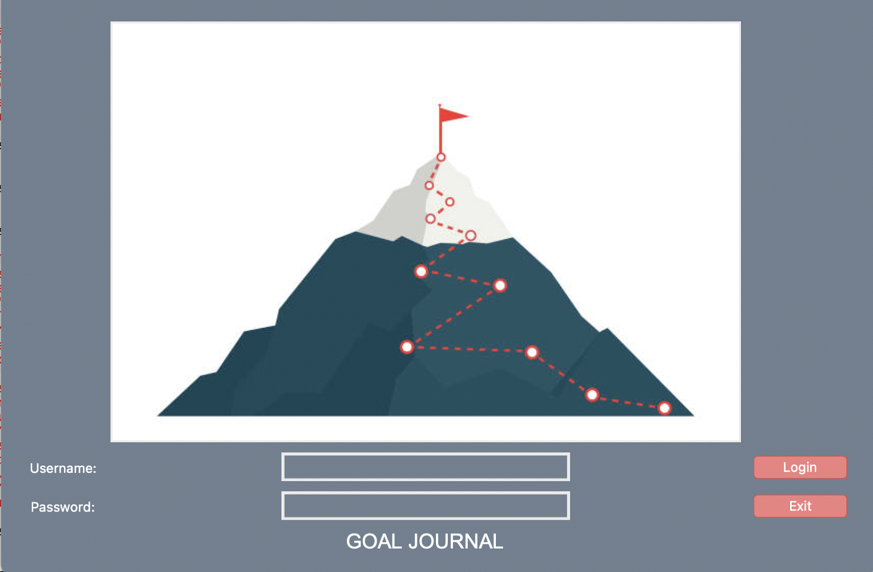
Login Page
First window when program is running
Has user provide username and password
Logo
Login Button
Exit Button
Title at Bottom

Slide 9
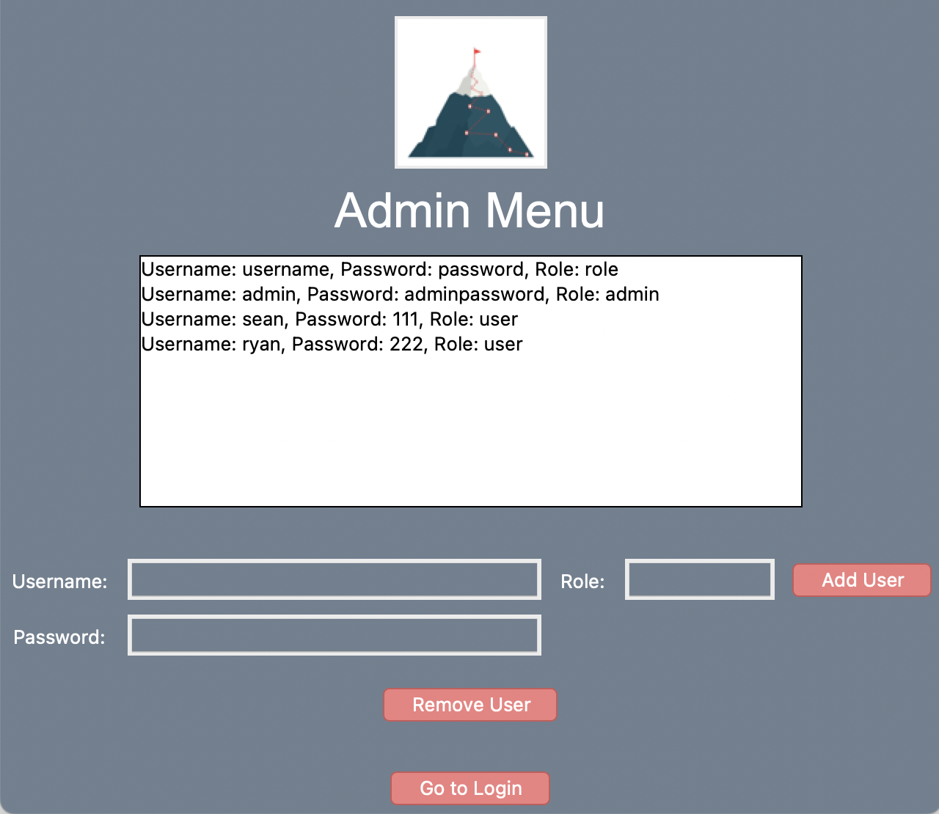
Admin Menu
Directed here when an admin logs in
List box displaying users
Add a user
Remove a user
Go to login button

Slide 10
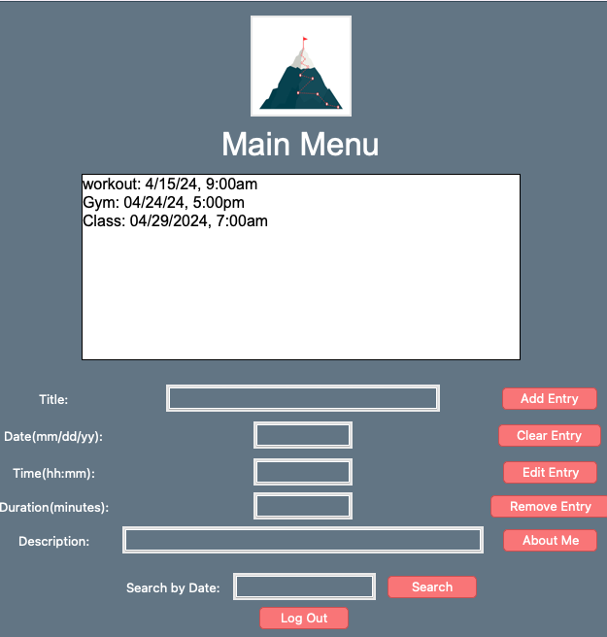
Main Menu
List box to display entries
Remove an edit entries use this list box to select an entry
Entries stored by: Title, Date, Time, Duration, Description.
Able to search by date
About me button

Slide 11
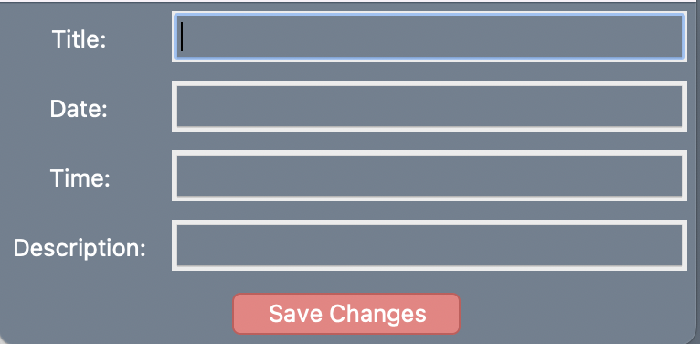
Edit Page
Select an entry from the list box, then click edit entry
Able to edit all information
Old entry will be deleted, and new will be saved when save changes is clicked
This is a pop-up window from the main menu
When changes are saved the window will close automatically

Slide 12
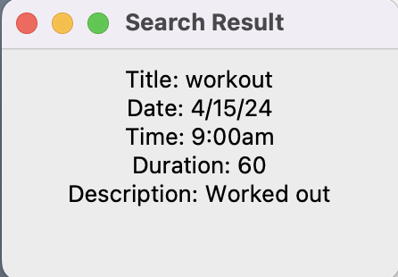
Search Pop-up
Pop-up window from menu when search is clicked
Searches by date so will display all entries from a date if there are multiple
To close, just close window and will be taken back to main menu

Slide 13
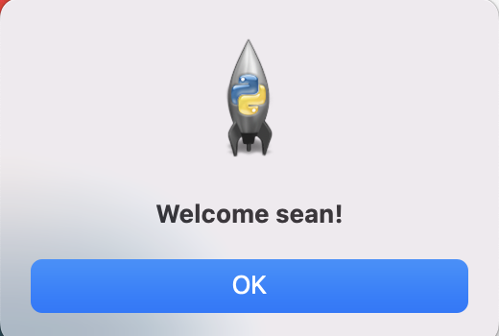
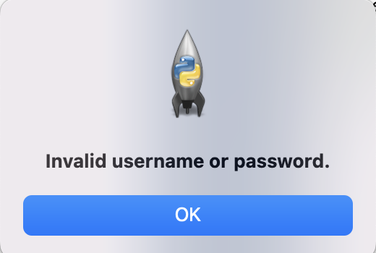
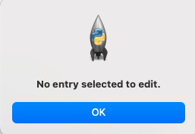
Pop-up windows
Successful login
Incorrect Login
Not selecting an entry to edit or remove

Slide 14
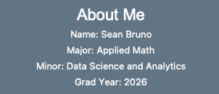
About Me Button
When about me button is clicked on, from the main menu
Added to give user information about the developer

Slide 15
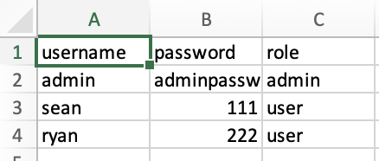
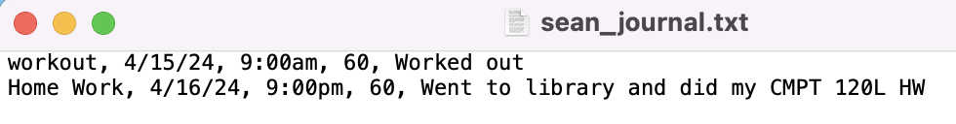
Data Storage
User login information stored in CSV
User journal entries stored in a txt file
Each user has their own txt file

Slide 16
References
Color List: https://matplotlib.org/stable/gallery/color/named_colors.html
Mountain Image: https://www.istockphoto.com/photos/reaching-goals-mountain
Tkinter GUI Guide: https://realpython.com/python-gui-tkinter/
CSV File Guide: https://www.analyticsvidhya.com/blog/2021/08/python-tutorial-working-with-csv-file-for-data-science/
Lucid Chart: https://www.lucidchart.com
Index Guide: https://www.geeksforgeeks.org/python-list-index/
Tkmacosx: https://pypi.org/project/tkmacosx/

